Slide 1
Topics to be Covered
Java Tokens
Data Types
Variables
Keywords
Operators
Typecasting
Control Statements
Selection Statements
Iteration Statements
Jumping Statements

Slide 2
Data Types

Slide 3
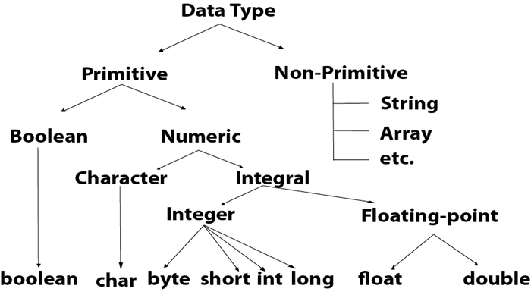
Data Types
Data types specify the different sizes and values that can be stored in the variable. There are two types of data types in Java:
Primitive data types: The primitive data types include boolean, char, byte, short, int, long, float, and double.
Non-primitive data types: The non-primitive data types include Classes, Interfaces, and Arrays.

Slide 4
Data Types
DATA TYPE | DEFAULT VALUE | DEFAULT SIZE
boolean | false | 1 bit
char | ‘\u0000’ | 2 byte
byte | 0 | 1 byte
short | 0 | 2 byte
int | 0 | 4 byte
long | 0L | 8 byte
float | 0.0f | 4 byte
double | 0.0d | 8 byte

Slide 5
Variables

Slide 6
Variables
A variable is a container which holds the value while the Java program is executed. A variable is assigned with a data type.
There are three types of variables in java: local, instance and static.
1) Local Variable
A variable declared inside the body of the method is called local variable. You can use this variable only within that method. Note: A local variable cannot be defined with "static" keyword.
2) Instance Variable
A variable declared inside the class but outside the body of the method is called an instance variable. It is not declared as static.
It is called an instance variable because its value is instance-specific and is not shared among instances.
3) Static variable
A variable that is declared as static is called a static variable. It cannot be local. You can create a single copy of the static variable and share it among all the instances of the class. Memory allocation for static variables happens only once when the class is loaded in the memory.

Slide 7
Variables
Example :
public class A
{
static int m=100;//static variable
void method()
{
int n=90;//local variable
}
public static void main(String args[])
{
int data=50;//instance variable
}
}//end of class

Slide 8
Keywords

Slide 9
Keywords
Java keywords are also known as reserved words.
Keywords are particular words that act as a key to a code.
These are predefined words by Java so they cannot be used as a variable or object name or class name.
Sample Keywords:
abstract | boolean | break | byte
case | catch | char | class
continue | default | do | double
else | enum | extends | final
finally | float | for | if
implements | import | instanceof | interface
long | new | package | Protected
static | super | switch | throw
try | void | volatile | while

Slide 10
Operators

Slide 11
Operators
Operator in Java is a symbol that is used to perform operations.
There are many types of operators in Java which are given below:
Unary Operator (++,--,~,!)
Arithmetic Operator(+,-,*,/,%)
Shift Operator (<<,>>,>>>)
Relational Operator (<,>,<=,>=,==,!=)
Bitwise Operator ( &,|,^)
Logical Operator ( &&, ||)
Ternary Operator ( ?:)
Assignment Operator (=, += ,-=, *=, /=, %= ,&=, ^=, |=, <<=, >>=, >>>= )

Slide 12
Operators : Difference between >> and >>> in java
In Java, >> and >>> are both bitwise right shift operators, but they behave differently depending on the type of the variable being shifted.
These operators are used to shift the bits of a number to the right by a specified number of positions.
>> (Signed Right Shift):
The >> operator performs a signed right shift, which means it preserves the sign bit (the leftmost bit) of the number being shifted.
It fills the vacated positions on the left with the value of the sign bit. When used with a signed integer (e.g., int, long), it performs an arithmetic right shift.
Example:
int num = -10; // Binary: 1111 1111 1111 1111 1111 1111 1111 0110
int result = num >> 2; // Binary: 1111 1111 1111 1111 1111 1111 1111 1101
System.out.println(result); // Output: -3

Slide 13
Operators : Difference between >> and >>> in java
>>> (Unsigned Right Shift):
The >>> operator performs an unsigned right shift, which means it always fills the vacated positions on the left with zeros, regardless of the sign bit.
When used with an unsigned integer (e.g., int, long), it effectively divides the number by 2^shift_amount.
Example:
int num = -10; // Binary: 1111 1111 1111 1111 1111 1111 1111 0110
int result = num >>> 2; // Binary: 0011 1111 1111 1111 1111 1111 1111 1101
System.out.println(result); // Output: 1073741821

Slide 14
Typecasting

Slide 15
Typecasting
Typecasting in Java is the process of converting a value from one data type to another.
It allows you to explicitly convert variables from one type to another when needed.
Typecasting is necessary when you want to assign a value of one data type to a variable of another data type, but the two types are not compatible.
There are two types of typecasting in Java:
Implicit (Widening)
Explicit (Narrowing )
Implicit Typecasting (Widening Conversion) :
Implicit typecasting happens automatically when a smaller data type is converted to a larger data type. Java handles this conversion implicitly without requiring any explicit code.
Explicit Typecasting (Narrowing Conversion):
Explicit typecasting is required when you want to convert a larger data type to a smaller data type, which may result in a potential loss of data. You need to explicitly specify the target data type in parentheses before the value or variable to perform the conversion.

Slide 16
Typecasting
Ex: Implict Typecasting
public class implicitEx
{
public static void main(String[] args)
{
int myInt = 100;
// Implicit typecasting from int to long
long myLong = myInt;
System.out.println("Integer value: " + myInt);
System.out.println("Long value: " + myLong);
}
}
Ex: Explicit Typecasting
public class ExplicitEx
{
public static void main(String[] args)
{
double myDouble = 123.45;
// Explicit typecasting from double to int
int myInt = (int) myDouble;
System.out.println("Double value: " + myDouble);
System.out.println("Integer value: " + myInt);
}
}

Slide 17
Control Statements

Slide 18
Control Statements
Java compiler executes the code from top to bottom. The statements in the code are executed according to the order in which they appear.
However, Java provides statements that can be used to control the flow of Java code. Such statements are called control flow statements. It is one of the fundamental features of Java, which provides a smooth flow of programs.
Java provides three types of control flow statements.
Decision-Making statements
if statements
switch statement
Loop statements
while loop
do while loop
for loop
for-each loop (will be discussed in Arrays)
Jump statements
break statement
continue statement

Slide 19
Decision Making Statements

Slide 20
Control Statements
Decision-Making statements:
As the name suggests, decision-making statements decide which statement to execute and when. Decision-making statements evaluate the Boolean expression and control the program flow depending on the result of the condition provided.
There are two types of decision-making statements in Java, i.e., If statement and switch statement.
1) If Statement:
In Java, the "if" statement is used to evaluate a condition.
The control of the program is diverted depending upon the specific condition.
The condition of the If statement gives a Boolean value, either true or false.
In Java, there are four types of if-statements given below.
-> Simple if statement
-> if-else statement
-> if-else-if ladder
-> Nested if-statement

Slide 21
Control Statements : Simple if
Syntax:
if(condition)
{
//code to be executed
}
Example:
public class Example1
{
public static void main(String[] args)
{
//defining an 'age' variable
int age=20;
//checking the age
if(age>18)
{
System.out.print("Age is greater than 18");
}
}
}
Output:
Age is greater than 18

Slide 22
Control Statements: if..else
Syntax:
if(condition)
{
//code if condition is true
}
else
{
//code if condition is false
}
public class Example2
{
public static void main(String[] args)
{
int number=13;
if(number%2==0)
{
System.out.println(“Even Number");
}
else
{
System.out.println(“Odd Number");
}
}
}
Output:
Odd Number

Slide 23
Control Statements : if..else if .. else
Syntax:
if(condition1)
{
// if condition1 is true
}
else if(condition2)
{
//if condition2 is true
}
else if(condition3)
{
//if condition3 is true
}
...
else
{
//if all the conditions are false
}
public class Example3
{
public static void main(String[] args)
{
int number=-13;
if(number>0)
{
System.out.println("POSITIVE");
}
else if(number<0)
{
System.out.println("NEGATIVE");
}
else
{
System.out.println("ZERO");
}
}
}
Output: NEGATIVE

Slide 24
Control Statements : nested if
Syntax:
if(condition)
{
//code to be executed
if(condition)
{
//code to be executed
}
}
public class Example4
{
public static void main(String[] args)
{
int age=20;
int weight=80;
if(age>=18)
{
if(weight>50)
{
System.out.println("You are eligible to donate blood");
}
}
}
}
Output:
You are eligible to donate blood

Slide 25
Control Statements : switch statement
2) switch statement:
The Java switch statement executes one statement from multiple conditions. It is like if-else-if ladder statement.
The switch statement works with byte, short, int, long, enum types, String and some wrapper types like Byte, Short, Int, and Long. Since Java 7, you can use strings in the switch statement.
In other words, the switch statement tests the equality of a variable against multiple values.
Points to be remembered:
There can be one or N number of case values for a switch expression.
The case value must be of switch expression type only. The case value must be literal or constant. It doesn't allow variables.
The case values must be unique. In case of duplicate value, it renders compile-time error.
The Java switch expression must be of byte, short, int, long (with its Wrapper type), enums and string.
Each case statement can have a break statement which is optional. When the control reaches to the break statement, it jumps the control after the switch expression. If a break statement is not found, it executes the next case.
The case value can have a default label which is optional.

Slide 26
Control Statements : switch statement
Syntax:
switch(expression)
{
case value1:
//code to be executed;
break;
case value2:
//code to be executed;
break;
......
default:
code to be executed if all cases are not matched;
}

Slide 27
Control Statements : switch statement
public class Example5
{
public static void main(String[] args)
{
int number=20;
switch(number)
{
case 10:
System.out.println("10 is printed");
break;
case 20:
System.out.println("20 is printed");
break;
case 30:
System.out.println("30 is printed");
break;
default:
System.out.println("Not in 10, 20 or 30");
}
}
}
Output: 20 is printed

Slide 28
Control Statements : switch statement
public class Example6
{
public static void main(String[] args)
{
String levelString="Expert";
int level=0;
switch(levelString)
{
case "Beginner": level=1;
break;
case "Intermediate": level=2;
break;
case "Expert": level=3;
break;
default: level=0;
break;
}
System.out.println("Your Level is: "+level);
}
}
Output: Your Level is : 3

Slide 29
Loop Statements

Slide 30
Control Statements
Looping statements:
When we need to execute one or more instructions of a program repeatedly, then we will use looping statements.
There are three types of looping statements:
while loop :
do..while loop
for loop
Every loop requires 3 steps :
Initialization : It defines the start value.
Test Condition : It defines the number of iterations/repetitions.
Change in value : Keeps the count of iterations.

Slide 31
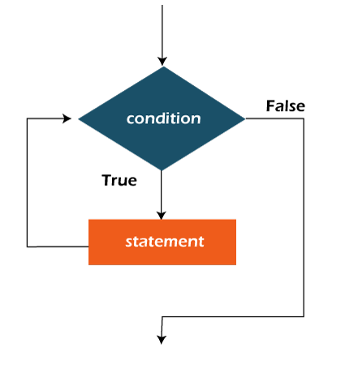
Control Statements : while loop
while loop:
The Java while loop is used to iterate a part of the program repeatedly until the specified Boolean condition is true. As soon as the Boolean condition becomes false, the loop automatically stops.
Note: If the number of iterations is not fixed, it is recommended to use the while loop.
Syntax:
Initialization
while (test condition)
{
//code to be executed
change in value
}

Slide 32
Control Statements : while loop
public class WhileEx1
{
public static void main(String[] args)
{
int i=1;
while(i<=10)
{
System.out.print(i + “ “);
i++;
}
}
}
Java Infinitive While Loop
If you pass true in the while loop, it will be infinitive
while loop.
Syntax :
while(true)
{
//code to be executed
}
Ex:
public class WhileEx2 {
public static void main(String[] args) {
while(true){
System.out.print(“Hello");
}
}
}
Output: 1 2 3 4 5 6 7 8 9 10
Output: HelloHelloHello…

Slide 33
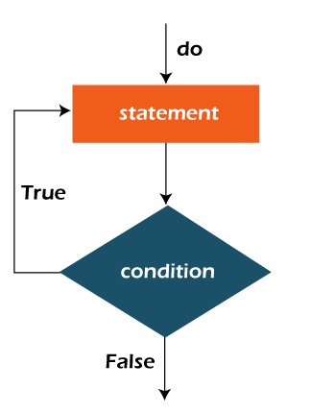
Control Statements : do..while loop
do..while loop:
The Java do-while loop is used to iterate a part of the program repeatedly, until the specified condition is true.
If the number of iteration is not fixed and you must have to execute the loop at least once, it is recommended to use a do-while loop. Java do-while loop is called an exit control loop.
Therefore, unlike while loop and for loop, the do-while check the condition at the end of loop body. The Java do-while loop is executed at least once because condition is checked after loop body
Syntax:
Initialization
do
{
//code to be executed
change in value
} while (test condition);

Slide 34
Control Statements: do..while loop
public class WhileEx1
{
public static void main(String[] args)
{
int i=1;
do
{
System.out.print(i + “ “);
i++;
} while(i<=10);
}
}
Java Infinitive While Loop
If you pass true in the while loop, it will be infinitive
while loop.
Syntax :
do
{
//code to be executed
} while(true);
Ex:
public class WhileEx2 {
public static void main(String[] args) {
do {
System.out.print(“Hello");
} while(true);
}
}
Output: 1 2 3 4 5 6 7 8 9 10
Output: HelloHelloHello…

Slide 35
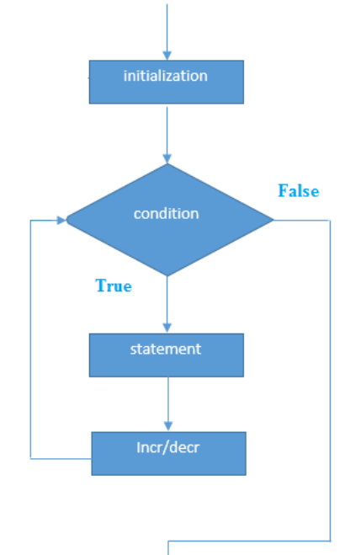
Control Statements : for loop
for loop:
It is the most compact loop. In for loop all the 3 parts are written in same line.
Syntax:
for(initialization; condition; increment/decrement)
{
//statement or code to be executed
}

Slide 36
Control Statements : for loop
Example:
public class ForEx1
{
public static void main(String[] args)
{
//Code
for(int i=1;i<=10;i++)
{
System.out.println(i);
}
}
}
Output:
1
2
3
4
5
6
7
8
9
10

Slide 37
Control Statements : nested for loop
Java Nested for Loop
If we have a for loop inside another loop, it is known as a nested for loop. The inner loop executes completely whenever the outer loop executes.
Example:
public class NestedForEx1
{
public static void main(String[] args)
{
for(int i=1;i<=3;i++)
{
for(int j=1;j<=3;j++)
{
System.out.println(i+" "+j);
} //end of inner loop
}//end of outer loop
}
}
Output:
1 1
1 2
1 3
2 1
2 2
2 3
3 1
3 2
3 3

Slide 38
Control Statements : nested for loop
Example:
public class PyramidEx
{
public static void main(String[] args)
{
for(int i=1;i<=5;i++)
{
for(int j=1;j<=i;j++)
{
System.out.print("* ");
}
System.out.println();//new line
}
}
}
Output:
*
* *
* * *
* * * *
* * * * *

Slide 39
Jumping Statements

Slide 40
Jumping Statements : break
In Java, jumping statements are used to control the flow of execution within a program by altering the sequence in which statements are executed.
These statements allow you to skip or repeat certain parts of the code based on specific conditions. There are three main jumping statements in Java:
1. break:
The break statement is commonly used within loops (such as for, while, or do-while) and switch statements. When encountered, it immediately terminates the innermost loop or exits the switch statement, transferring control to the next statement after the loop or switch.
Example of using the break in a loop:
for (int i = 1; i <= 10; i++)
{
if (i == 5)
{
break; // Exit the loop when i becomes 5
}
System.out.print(i + " ");
}
// Output: 1 2 3 4

Slide 41
Jumping Statements : continue
2. continue:
The continue statement is also used within loops. When encountered, it immediately skips the current iteration of the loop and jumps to the next iteration.
Example of using continue in a loop:
for (int i = 1; i <= 5; i++)
{
if (i == 3)
{
continue; // Skip the iteration when i becomes 3
}
System.out.print(i + " ");
}
// Output: 1 2 4 5

Slide 42
Jumping Statements: return
3. return:
The return statement is used within methods to exit the method and return a value (if the method has a return type). It can also be used without any value to terminate the method without returning anything.
When the return statement is encountered, it stops the execution of the current method and passes control back to the calling method.
Example of using return in a method:
public int add(int a, int b)
{
return a + b; // Returns the sum of a and b and exits the method
}

Slide 43
Jumping Statements: label break
label break
In Java, you can use a labeled break statement to terminate a specific outer loop from within an inner loop. This allows you to break out of nested loops based on a certain condition.
The labeled break statement is especially useful when you have multiple nested loops, and you want to break out of a specific enclosing loop instead of just the innermost loop.
Syntax:
label_name: // This is the label
for (int i = 0; i < outerLoopLimit; i++)
{
for (int j = 0; j < innerLoopLimit; j++)
{
// Some condition that you want to check
if (condition)
{
break label_name; // This will break out of the outer loop
}
}
}

Slide 44
Jumping Statements: label break
Example :
public class LabeledBreakEx
{
public static void main(String[] args)
{
outerLoop: // Label for the outer loop
for (int i = 1; i <= 3; i++)
{
System.out.println("Outer Loop Iteration: " + i);
for (int j = 1; j <= 3; j++)
{
System.out.println("Inner Loop Iteration: " + j);
if (i == 2 && j == 2)
{
// This will break out of the outer loop when i=2 and j=2
break outerLoop;
}
}
}
}
}
Output:
Outer Loop Iteration: 1
Inner Loop Iteration: 1
Inner Loop Iteration: 2
Inner Loop Iteration: 3
Outer Loop Iteration: 2
Inner Loop Iteration: 1
Inner Loop Iteration: 2

Slide 45
Jumping Statements: label continue
label continue
In Java, you can use a labeled continue statement to skip the current iteration of a specific outer loop from within an inner loop.
The labeled continue statement allows you to continue with the next iteration of the specified outer loop instead of just the innermost loop.
Syntax:
label_name: // This is the label
for (int i = 0; i < outerLoopLimit; i++)
{
for (int j = 0; j < innerLoopLimit; j++)
{
// Some condition that you want to check
if (condition)
{
continue label_name; // This will break out of the outer loop
}
}
}

Slide 46
Jumping Statements: label continue
Example :
Output:
Outer Loop Iteration: 1
Inner Loop Iteration: 1
Inner Loop Iteration: 2
Inner Loop Iteration: 3
Outer Loop Iteration: 2
Inner Loop Iteration: 1
Inner Loop Iteration: 2
Outer Loop Iteration: 3
Inner Loop Iteration: 1
Inner Loop Iteration: 2
Inner Loop Iteration: 3
public class LabeledContinueExample
{
public static void main(String[] args)
{
outerLoop: // Label for the outer loop
for (int i = 1; i <= 3; i++)
{
System.out.println("Outer Loop Iteration: " + i);
for (int j = 1; j <= 3; j++)
{
System.out.println("Inner Loop Iteration: " + j);
if (i == 2 && j == 2)
{
// This will continue with the next iteration of the outer loop when i=2 and j=2
continue outerLoop;
}
}
}
}
}

Slide 47
Thank You

